Slide 1
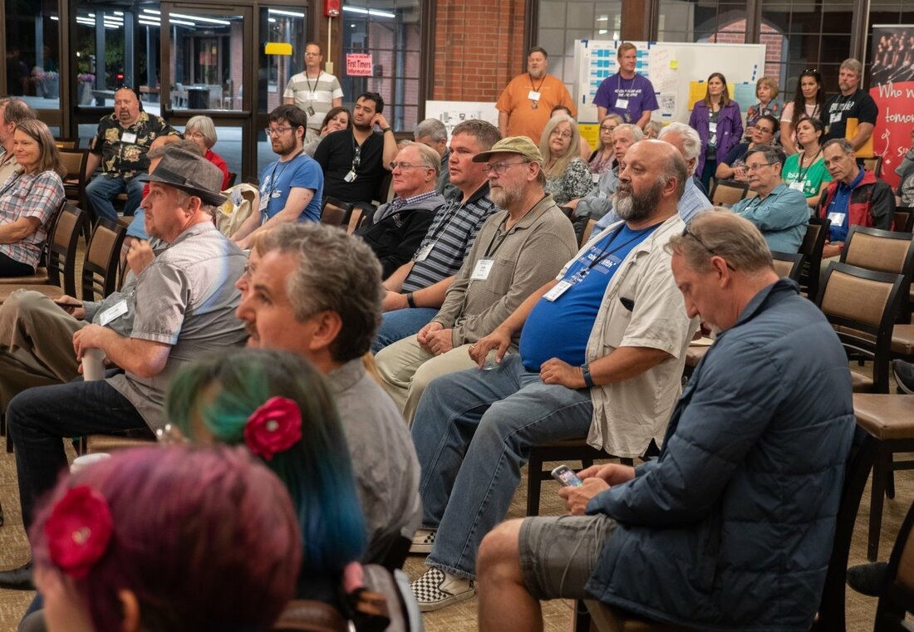
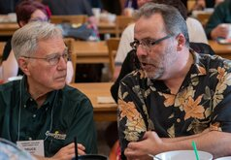
Practical Leadership
For Chapter
Presidents
Bill Hickman
EVP Evergreen District
bill@billhickman.com
425-419-7047

Slide 2
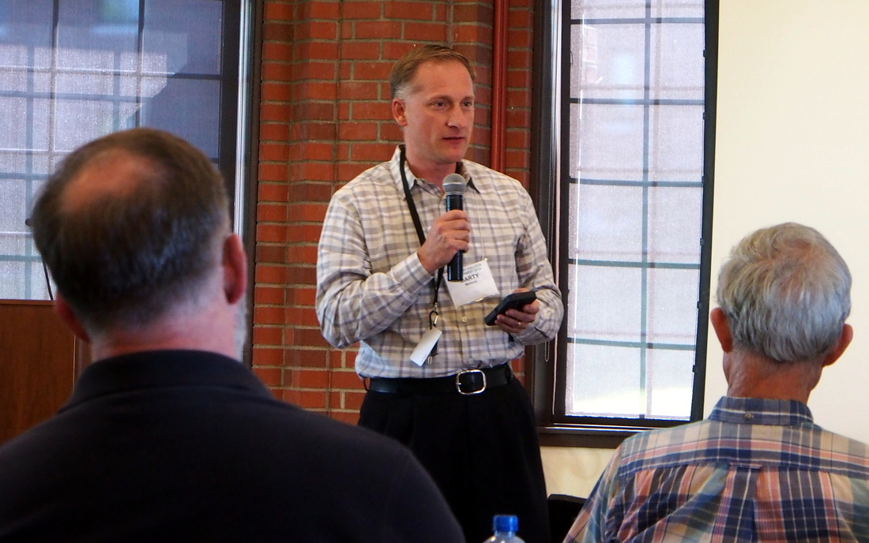
One of the most difficult things to understand about leadership is that you are not what you think you are. You are what you are perceived to be by others.
Basic Concept of Leadership
Eric Fromm
CEO Florida Power

Slide 3
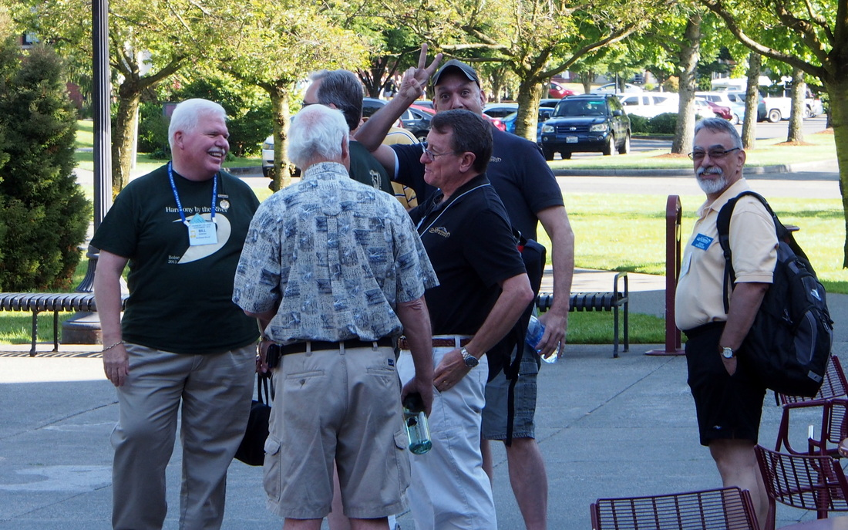

What is Leadership?
Results
Leader
Team
The ability to influence or inspire others to achieve the results envisioned by the leader.

Slide 4
Management vs. Leadership
Management is getting people to do the right thing..
Leadership is getting people to want do the right thing..
Warren Bennis
On Becoming A Leader

Slide 5
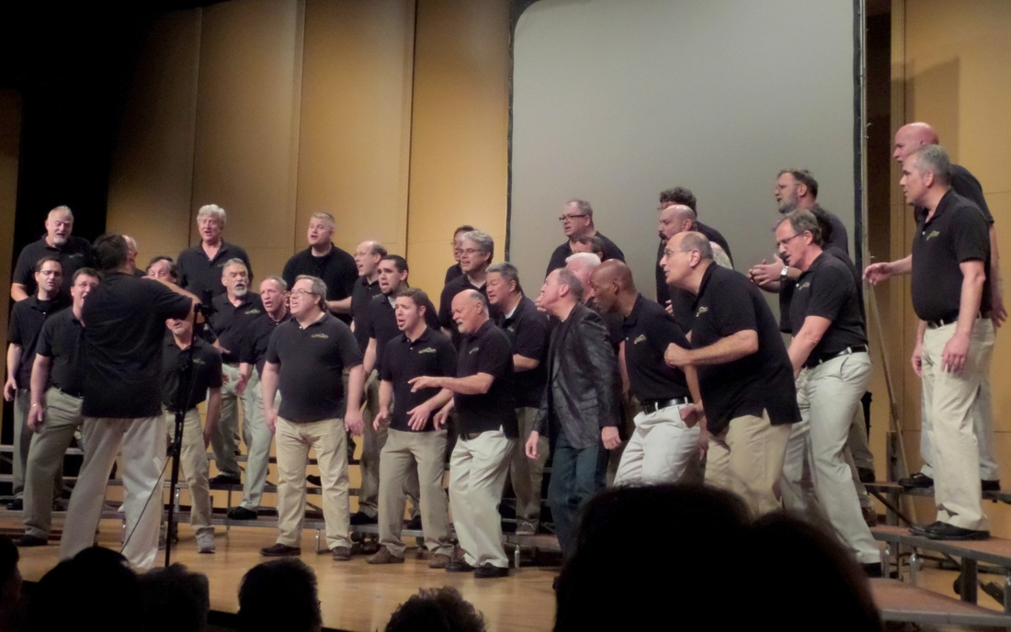
Key Point of Leadership
  Leadership has a purpose –
  to get something done!

Slide 6
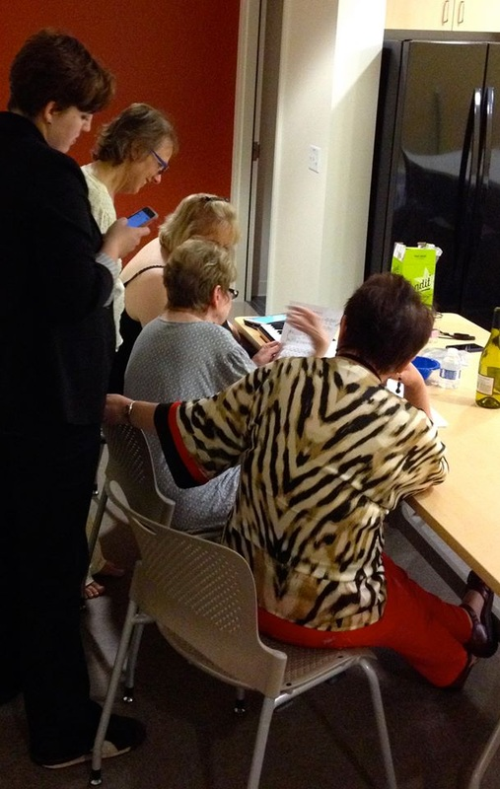

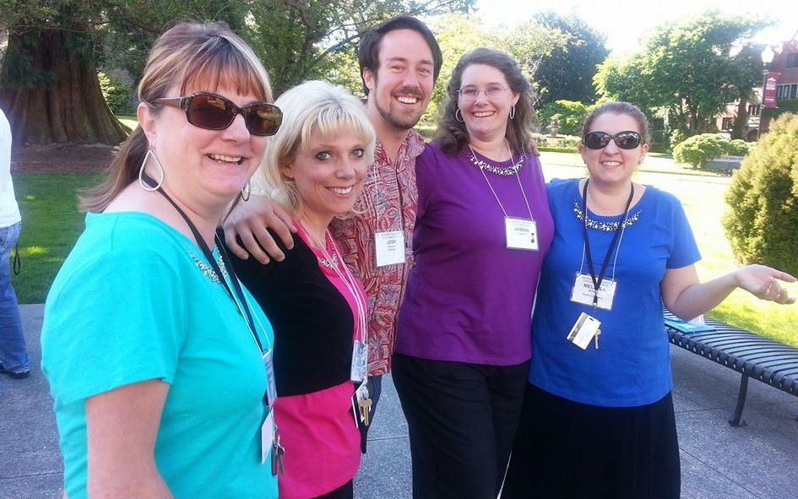
The Grand Secret of Leadership
The very best leaders take the time to establish…
Personal Connections!

Slide 7
The Leadership Skills You Need
  Skill # 1 – The Ability to Build Trust!
  Skill # 2 - The Ability to Communicate Effectively, which means…
            Asking Questions & Listening to the Answers!
  Skill # 3 –The Ability to Flex!
  Skill #4 – The Ability to Get Stuff Done !

Slide 8
Trust is Not Automatic
Lack of management trust is the biggest barrier to building effective organizations
– Development Dimensions Intl. Survey
61% don’t believe management tells them the truth
Council for Communication Study
Only 38% trust employers to keep their promises
– Princeton Survey Research Associates Study
This means you cannot assume trust!
Just like in business, chorus trust must be earned!

Slide 9

Skill # 1 – The Ability to Build Trust
What is trust? Define it.
What is the cost of low trust in a chorus?
What are the symptoms of low trust?
Is low trust a problem for you?
How Do You Know?

Slide 10
How to Build Trust
Continuity Maintain contact.
Be visible. Be there.
Caring Meet their needs.
Be a giver, not a taker.
Communication Share information, ideas, feelings.
Be genuine. Listen.
Competence Show skill in doing your job.
Seek continuous improvement.
One More Biggie…
Beware of Sarcasm or Teasing

Slide 11
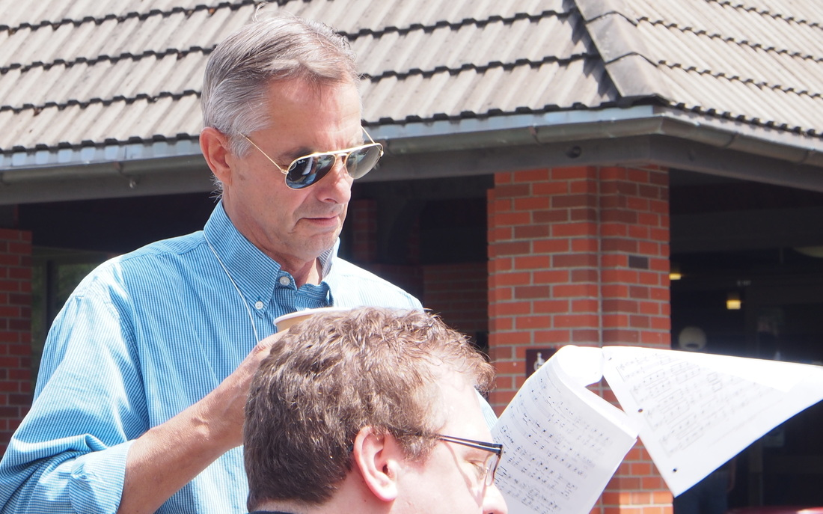
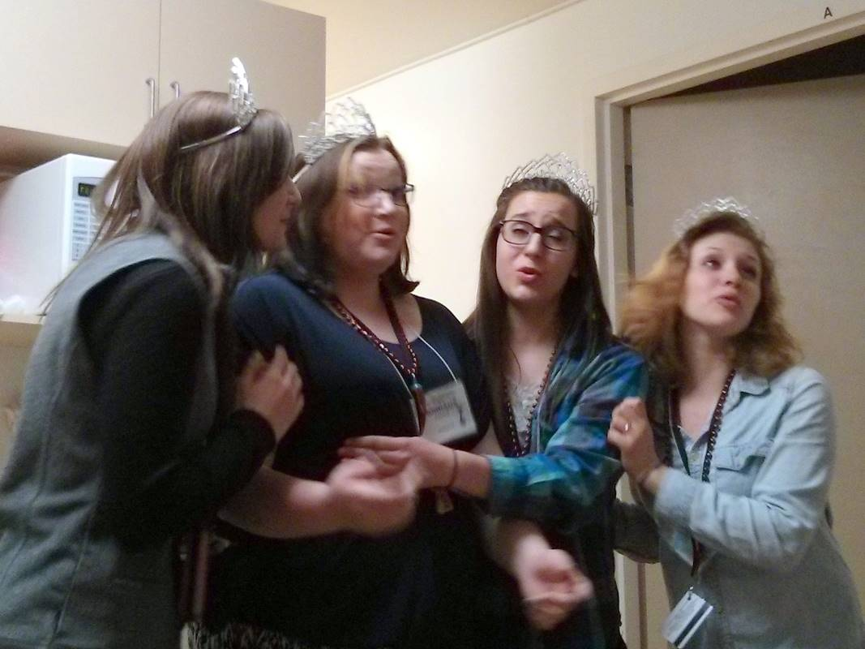
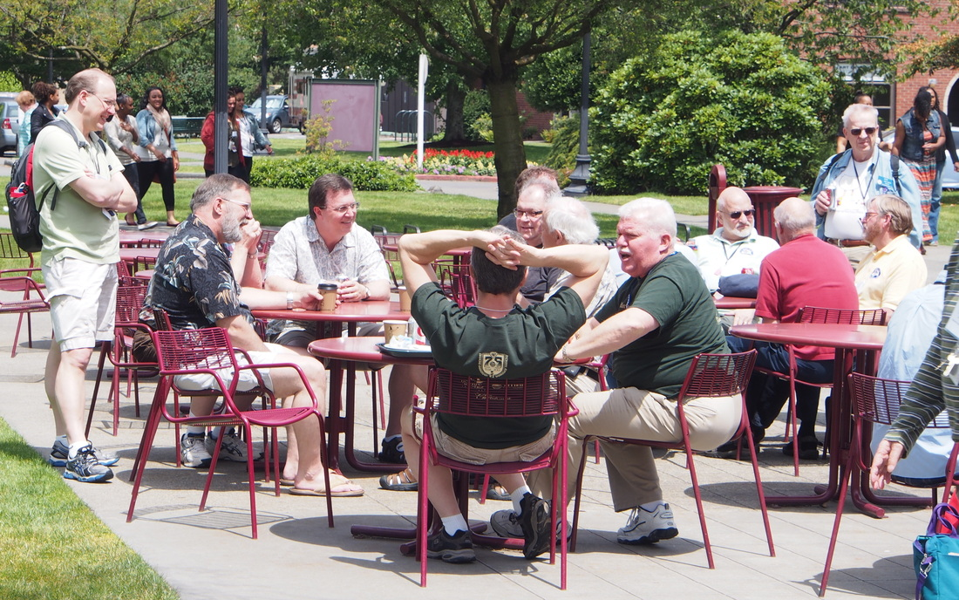
Skill # 2 – The Ability to Communicate Effectively
Communication is
Shared Meaning!

Slide 12
Effective Communication has…
What if?
What?
When?
How?
Who?
Purpose!

Slide 13
Communication Problems
Are You Causing Them?

Slide 14
Make Your Message Understood
Simplicity Keep your message simple.
Consistency Organize to stay “on message.”
Repetition Repeat your message.
Simplicity, consistency, and repetition – that’s how you get through.
Jack Welch

Slide 15
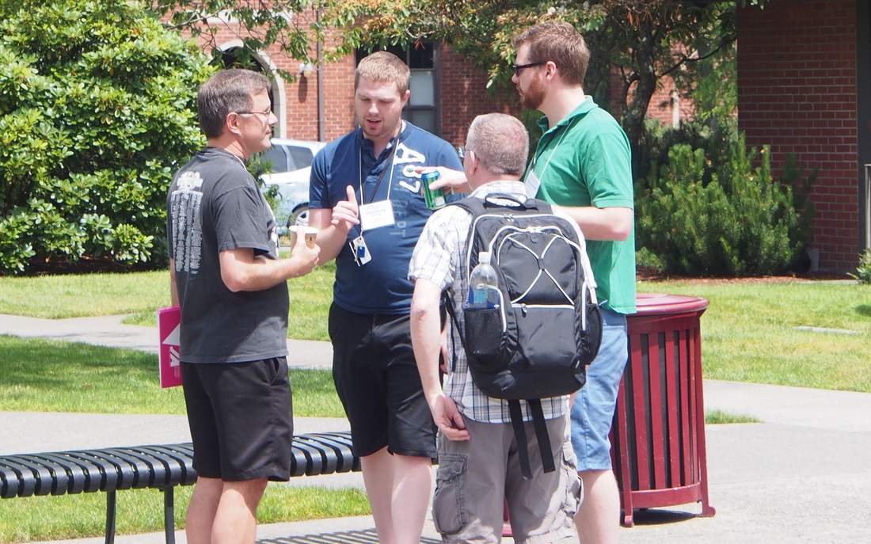
The Most Difficult Part
Listening!

Slide 16
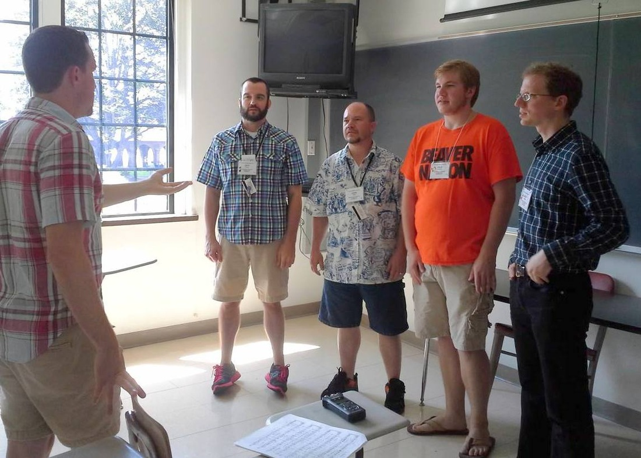
Levels of Listening
Pretend Listening
Selective Listening
Active Listening

Slide 17
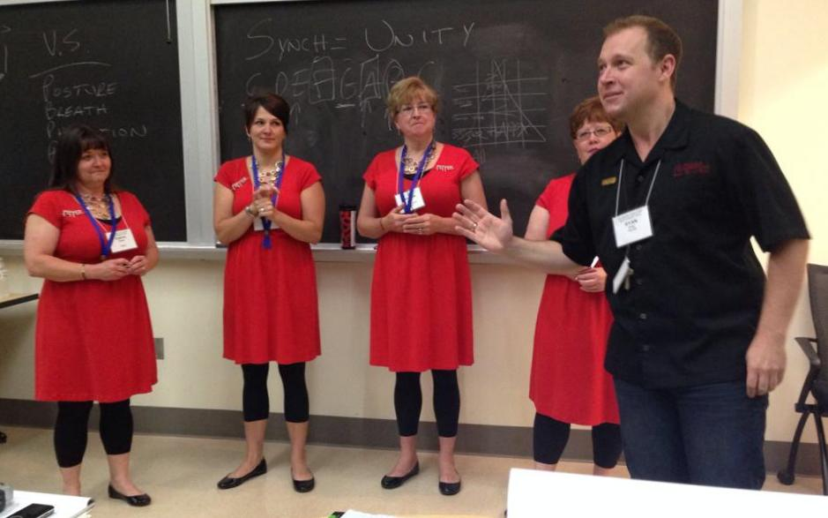
Active Listening - Follow the A’s
Absorb what was said
Ask a question to prompt, probe or clarify
Absorb what was said
Ask a question
Get the point?

Slide 18
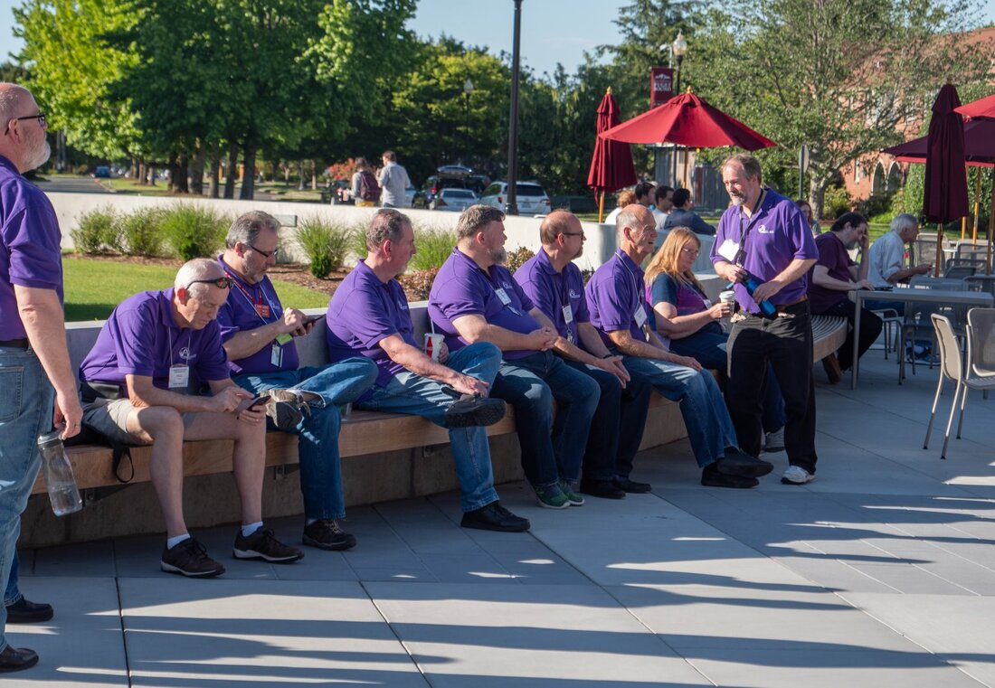
Skill # 3 – The Ability to Flex
Your Communications!

Slide 19
Communication Style
High Assertiveness
Low Expressiveness High Expressiveness
Low Assertiveness
Systematic

Slide 20

Skill # 4 – The Ability to Get Stuff Done!
Think before you act
Ask appropriate questions and
Listen – Carefully!
Shift your mindset
Set the right expectations

Slide 21

How To Really Get Things Done
Think Before You Act!

Slide 22
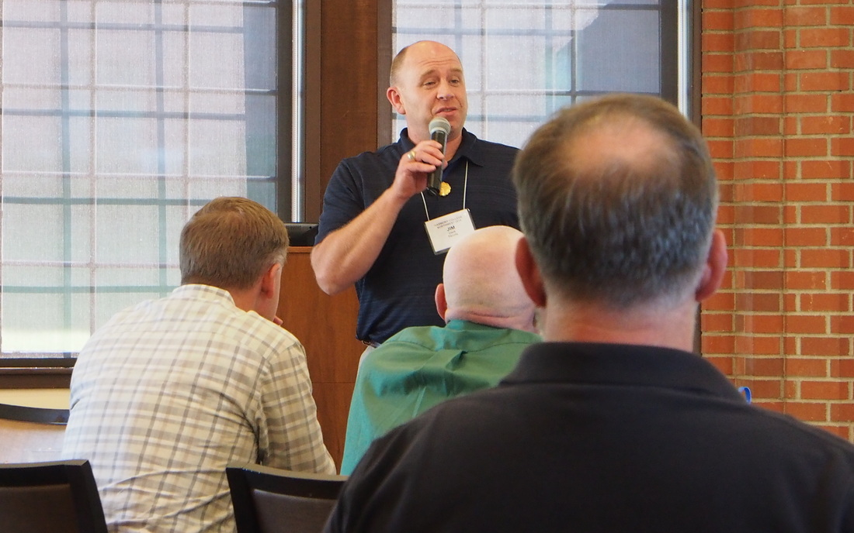
How To Really Get Things Done
Ask Appropriate Questions!

Slide 23
Leadership Questions
Question 1 What’s been going well?
Question 2 What’s not been going well?
Question 3 What could be done better?

Slide 24
How To Ask Questions
Ask one question at a time
Pause at the end of a question
Listen – Carefully!
Ask follow up questions
Say Thank You

Slide 25
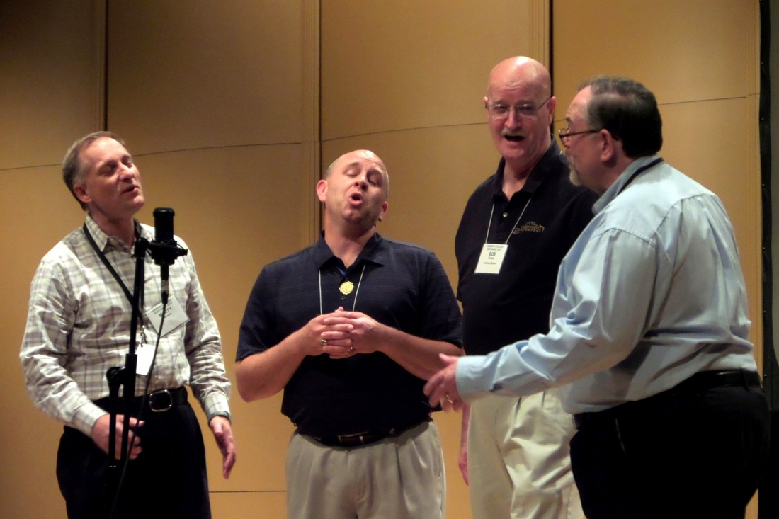
How To Really Get Things Done
Listen Carefully… & Shut Up!

Slide 26

How To Really Get Things Done
Shift Your Mind Set!
Which Really Means…

Slide 27

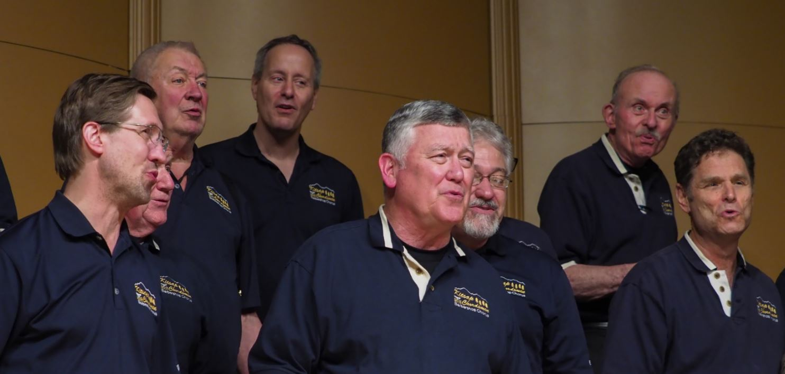
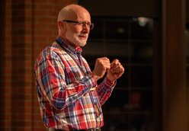
Get The Job Done!
What’s Your Job?
OK…but how?
It is really simple…

Slide 28
How To Really Get Things Done
Ask Questions and Listen to the Answers!
Assume You Do NOT Know The Answer!

Slide 29
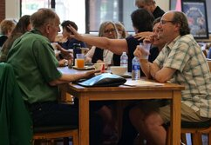
How To Really Get Things Done
Set the Right Expectations!

Slide 30
Resources For Presidents
Chapter President Workbook:
  https://drive.google.com/file/d/1C7dTMMqZi-12deNc_THvhpfidDgh7TIw/view
The Business of Barbershop
  https://drive.google.com/file/d/0B06bQhVih7-DQ2hLWklkaTQ2NWs/view?resourcekey=0-OzKZDWGCE306NPrmiIqX0A
A Guide to Financial Reviews
  https://drive.google.com/file/d/0B06bQhVih7-DNTF3N0lFOEFjRFk/view?resourcekey=0--U-D0dzuLt1wi1nQVFsvkQ

Slide 31
Questions?
?
?
?
?
?
?
?
?
?
?
?
?
?
?
?
?

Slide 32
Practical Leadership
For Chapter
Presidents
Bill Hickman
EVP Evergreen District
bill@billhickman.com
425-419-7047

